Slide 1



Online Fraud Detection
Room Number : 243

Slide 2
Team Members
Rohini.U
Anusha.R
Pranathi.Y
Mounika.V
Pratyusha.N
Harshitha.S
Pravalika.P
Anusha.G

Slide 3

Introduction
In an increasingly digital financial landscape, the threat of online fraud looms large. Our project focuses on the development of a robust and efficient online fraud detection system. By leveraging advanced machine learning algorithms, we aim to safeguard financial transactions by swiftly identifying and mitigating fraudulent activities.
3

Slide 4

Libraries
Machine Learning Libraries
Pandas
Matplotlib
NumPy
Seaborn
Scikit-learn(SK Learn)

Slide 5
Decision Tree Algorithm
The decision tree algorithm is a powerful machine learning technique used for classification and regression tasks. It operates by recursively splitting the dataset based on features, creating a tree-like structure where each node represents a decision based on a specific feature.
Decision nodes determine the feature to split upon, and leaf nodes provide the final output, whether a class label in classification or a numerical value in regression. Decision trees are easy to interpret and can model complex relationships in the data.
Benefits
Interpretability
Feature Importance
Robustness
5

Slide 6
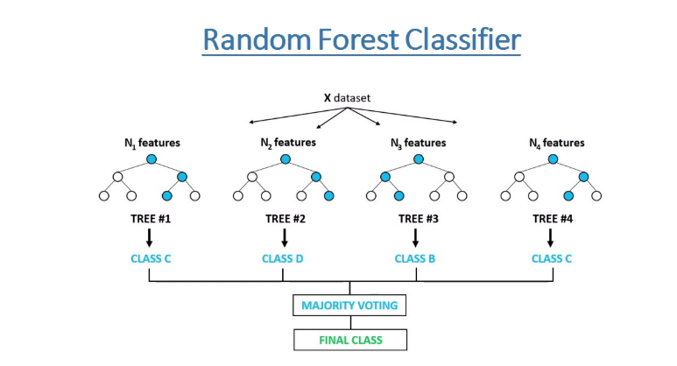
Algorithm Implementation
Data Preprocessing
Dataset Splitting
Model Selection
Hyperparameter Tuning
Model Training
Model Evaluation
Performance Analysis
Cross-Validation
Model Deployment
Monitoring and Manitenance
6

Slide 7

Benefits
Financial Security
Trust Building
Cost Savings
Compliance
Data Insights
Improved Reputation
Early Detection
Global Covering
Risk Management
Prevents Account Takeover
Fraud Pattern Analysis
7

Slide 8

Future Enhancement
Machine Learning Model Optimization
Real-Time Alerts
Multi-Channel Integration
AI-Powered Predictive Analytics
Blockchain Integration
Continuous Data Enrichment
Enhanced User Authentication
Geolocation Verification
8

Slide 9




Conclusion
Our Online Fraud Detection project demonstrates the critical role technology plays in safeguarding financial transactions. As we continue to evolve and enhance this system, we remain committed to ensuring the security and trustworthiness of digital transactions in an ever-changing financial landscape.
Thank You

